Slide 1
CSE 111 Project
Interest and Inflation Rates
By Benjamin Crawford

Slide 2
Demo
Didn’t create a working frontend/application

Slide 3
Use Case
The user would sign up or log in to access the feature on the website.
Some features available on the website would be to check interest rates, inflation rates throughout the months from 2000 to modern available statistics.
The user would be allowed to enter their wages into a year and see how much the wage should be if it were to keep up with inflation.

Slide 4
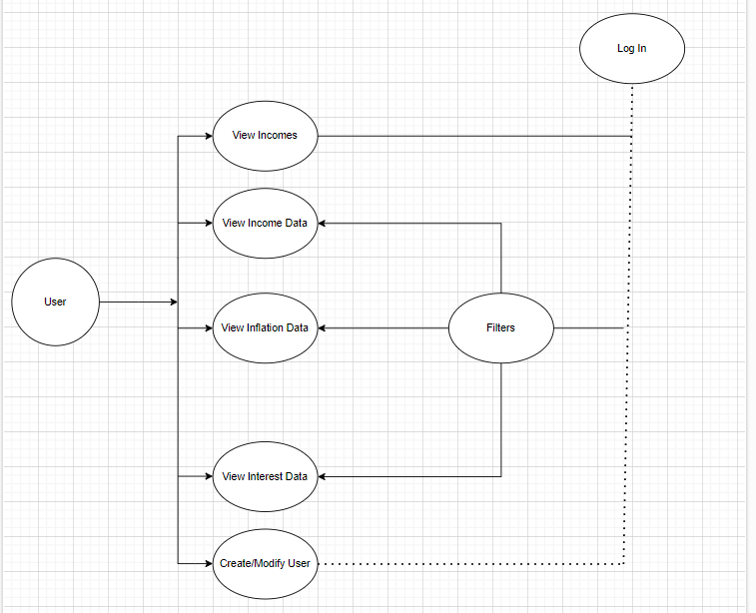
Use Case Diagram

Slide 5
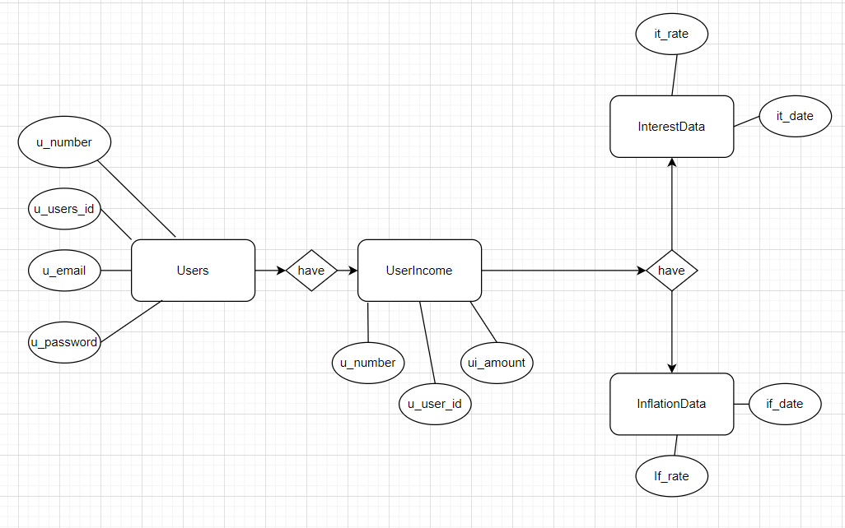
E/R Diagram

Slide 6
Relational Schema
Table Users: u_number, u_id, u_email, u_password
Table UserIncome: u_number, u_income, u_number
Table Inflation: inf_date, inf_rate
Table Interest: int_date, int_rate

Slide 7
Implementation
Sqlite3
Html, bootstrap
Node js and java

